Slide 1
Project 4
Predicting Stock price
By alex lu

Slide 2
Problem
Predicting today’s stock price based on past 7 days open, close, low, high and volume data.
As an example, we use apple stock in our modeling. We will predict apple stock’s closing price based on past 7 days’ open, close, low, high and volume data.

Slide 3
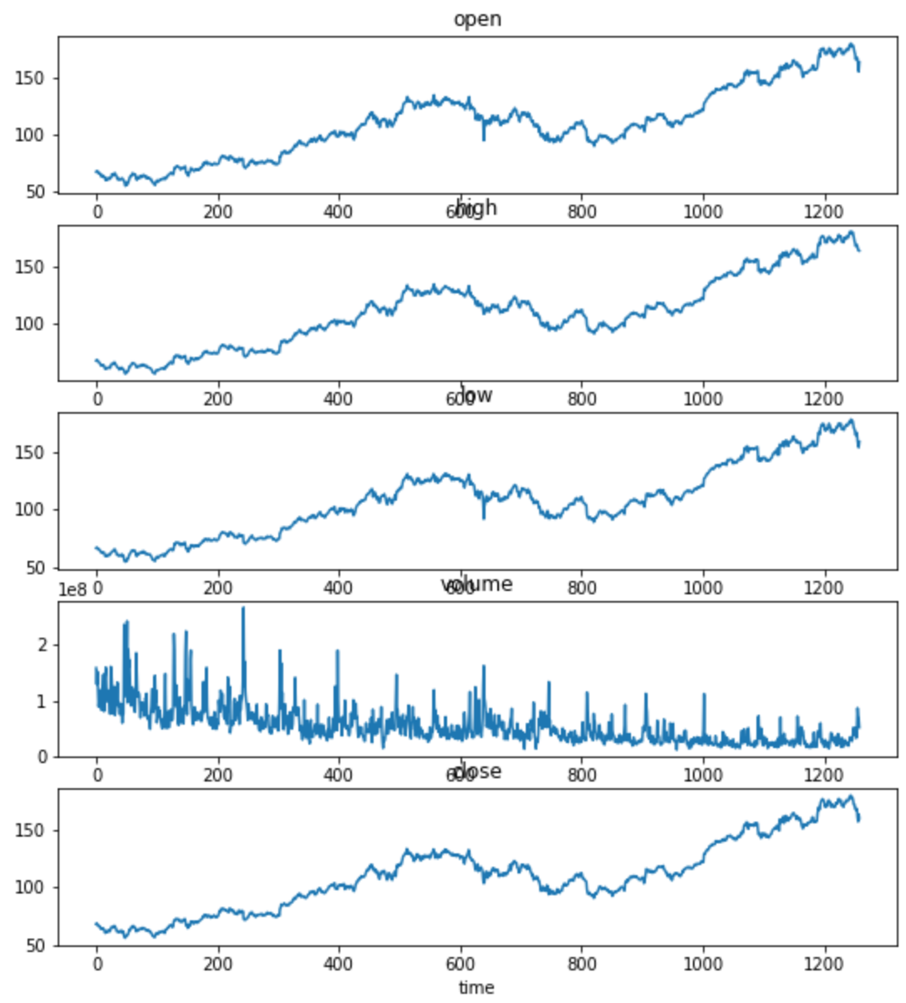
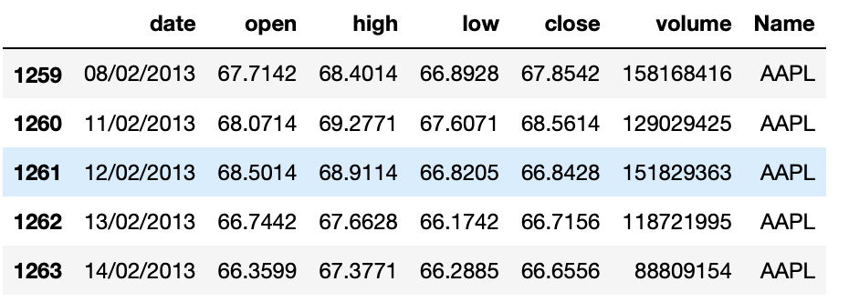
Data
Raw Data: source Kaggle. Very clean. First glance makes sense.

Slide 4
Solution
Intuition: a technical trader often takes consideration of previous days trading momentum when making a decision to buy or sell on any given day. These momentum are reflected in past historic price action: What were the volume in the stock? Was it making higher highs or lower lows? Was closed at bottom of the daily range or top?
Long Short Term Memory (LSTM) model: LSTM is type of RNN neutral network model that solves long time lag, and it is often used for time series problems like the one we are working on.

Slide 5
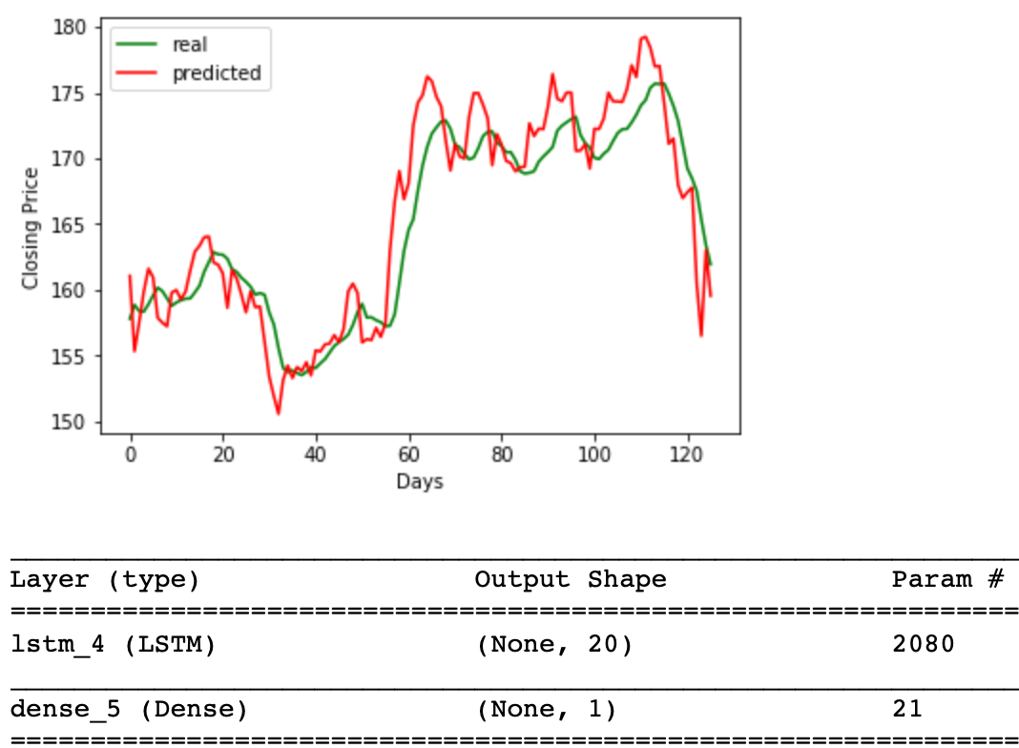
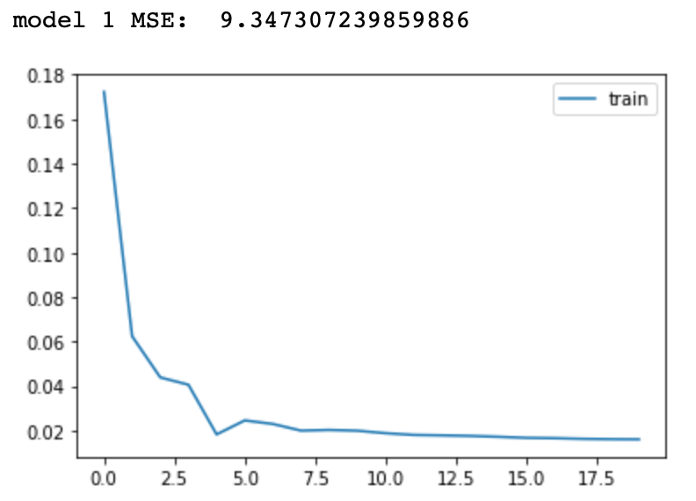
Results
Compare different models based on Mean Squared Error (MSE) measure, the simple model with one LSTM layer and one dense layer became the winner with MSE of 9.3. When comparing predicted closing price vs actual in the testing data, graphically, they tracks very well.

Slide 6
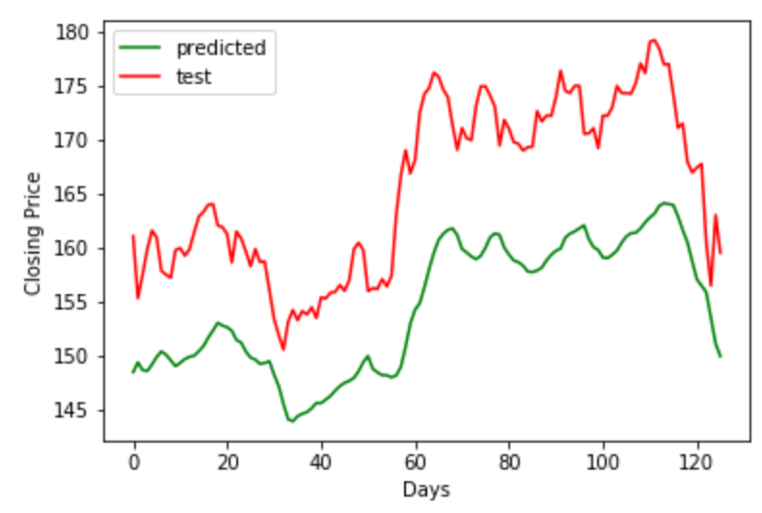
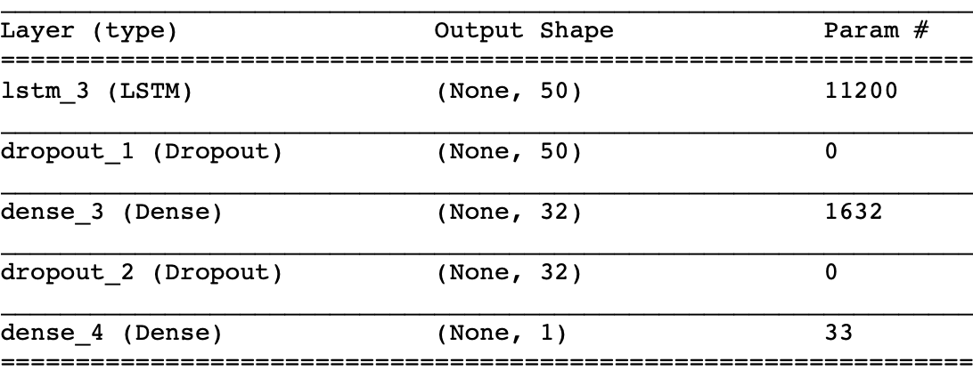
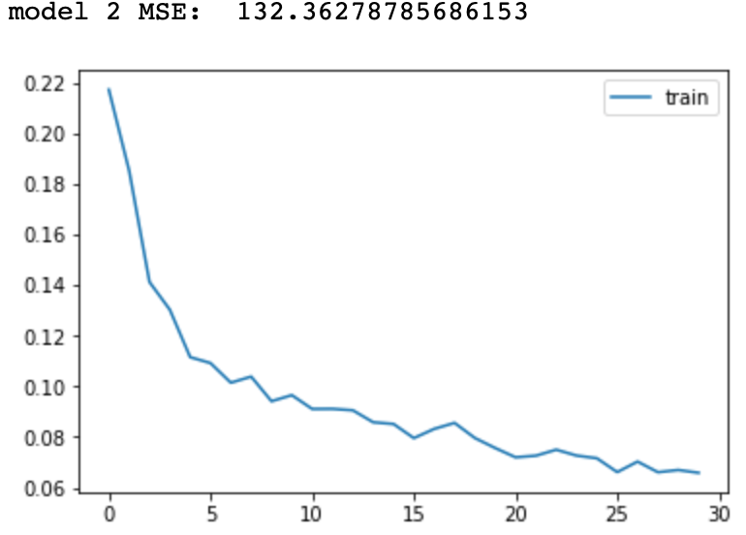
Results with other parameters
Model 2:
1x Lstm 50 nodes
1x Dense layer with relu activation
1x Dense layer with linear activation
Result: Terrible

Slide 7
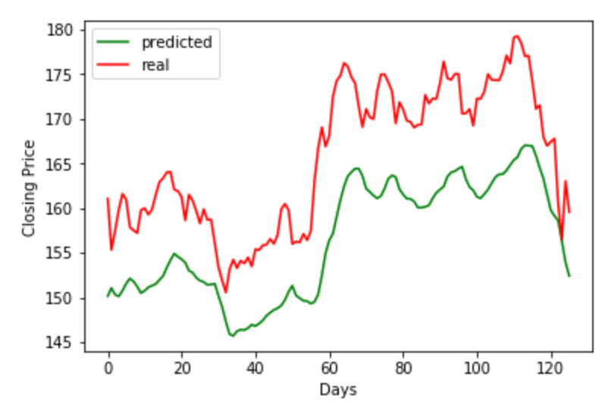
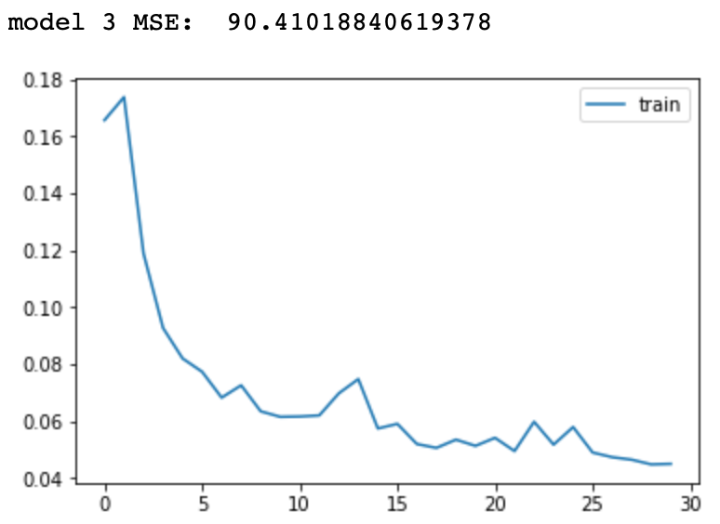
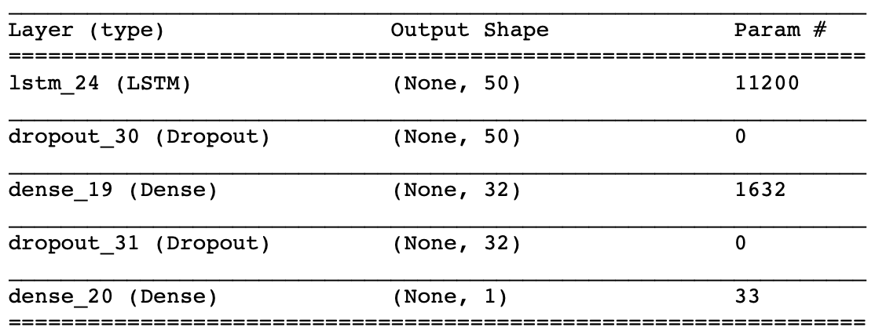
Results with other parameters
Model 3:
Same as Model 2 except activation linear
Result:
Better than model 2, but still terrible

Slide 8
Results with other parameters
Model 4:
3xx Lstm (testing with different node size 30, 40, 50)
2x Dense layer with linear activation
Result: the model with 50 nodes produced the best result among the 3 choices on node size. Overall result is Ok.

Slide 9
Conclusion
A simple LSTM model worked well in our case.
Complexity does not always improve modeling.
Business implication:
the model is a good guidance in a normal market trading environment.
However, the model is not suitable for prediction in unprecedented major event, such as 9/11 or financial crisis 2007.
When trading with this model, stop loss trigger should be implemented.

